Slide 1
LARC Overview
Enhancing HIV Service Delivery through a Quality Improvement Collaborative and Lab-Clinic Interface
Katy Yao, PhD
International Laboratory Branch
Division of Global HIV and TB Program, CGH
US Centers for Disease Control and Prevention
October 28, 2019
Harare, Zimbabwe

Slide 2




Presentation Outline
What is LARC?
Where did LARC come from?
What results have been achieved?
What’s next?

Slide 3
Presentation Outline
What is LARC?
Where did LARC come from?
What results have been achieved?
What’s next?

Slide 4
What is LARC?
A data-driven, process improvement program designed to enhance healthcare service delivery through multidisciplinary teamwork using a quality improvement approach
Program Goals:
To strengthen the viral load cascade to achieve better patient result (i.e., viral load suppression)
To improve institutional capability for viral load scale-up

Slide 5
LARC focuses on Demand Creation, Result Reporting, and Client Management in the viral load cascade.
Viral Load Cascade
Demand Creation for Testing
Specimen Collection and Processing
Sample Transport
Laboratory Testing
Result Reporting and Patient Management
Lab-Clinic Interface
Lab-Clinic Interface

Slide 6
Presentation Outline
What is LARC?
Where did LARC come from?
What results have been achieved?
What’s next?

Slide 7

African Regional Collaborative (ARC) for Nurses and Midwives, 2011-2017
Implemented in 18 countries in sub-Saharan Africa to:
strengthen HIV care for pregnant women and children
improve the quality of nursing practice
enhance national nursing policy and regulation

Slide 8

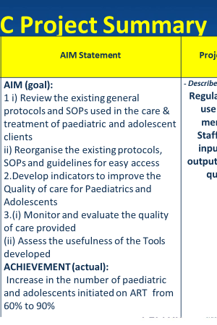

Slide 9


Laboratory African Regional Collaborative (LARC)
An extension of ARC

Slide 10






LARC 1.0 (2016-2017) tested the concept in 6 countries.
The Viral Load Cascade
Demand creation
Sample collection/ transport
Laboratory
testing
Result reporting
Patient management
Mozambique
Malawi
Kenya
Swaziland
Tanzania
Uganda
↑ VL tests ordered for eligible patients
↑ VL samples collected from eligible patients
↑ VL results
placed in
patient files
↑ Patients
with high VL
called for return visit
↑ Patients with high VL who returned for 1st EAC

Slide 11




The pilot resulted in measurable improvement in 10 months.
To increase the percentage of viral load samples collected from eligible patients from 45% (Jul 2016) to 80% by Aug 2017
To increase the percentage of viral load tests ordered for eligible patients from 0% (July 2016) to 80% by June 2017 in CPN, CCR, and ARV clinics
To increase the percentage of patients with viral load results placed in their files from 4% (October 2016) to 80% by June 2017
Mozambique
Malawi
Kenya
LARC Project
spread to
all Clinic
Clinician Education
All Clinic
Clinic Director Follow-up
Clinician Education began
Nationwide HCW strike
To increase the percentage of high viral load patients with documented timely follow-up from 12% (average from Dec’15 to June ‘16) to 80% by June 2017
To increase the percentage of high VL patients with a documented return visit from 35% (Oct 2016) to 100% by June 2017
To increase the percentage of high VL patients 1) contacted ≤ 1 week after results receipt from 27% to 90%, and 2) initiated with IAC ≤ 1 month from 6% to 90% between June 2016 and June 2017
Swaziland
Tanzania
Uganda
Baseline
HVL register implemented
IAC forms implemented
HVL stickers on patient files

Slide 12
LARC 2.0 (2018-2019) implemented a structured curriculum and refined delivery model in Kenya.
Standardized
Portable
Replicable

Slide 13
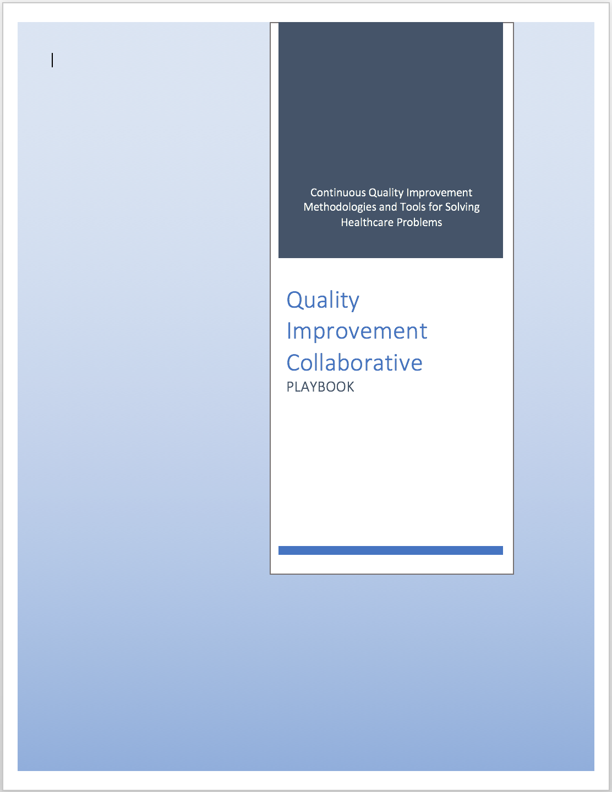
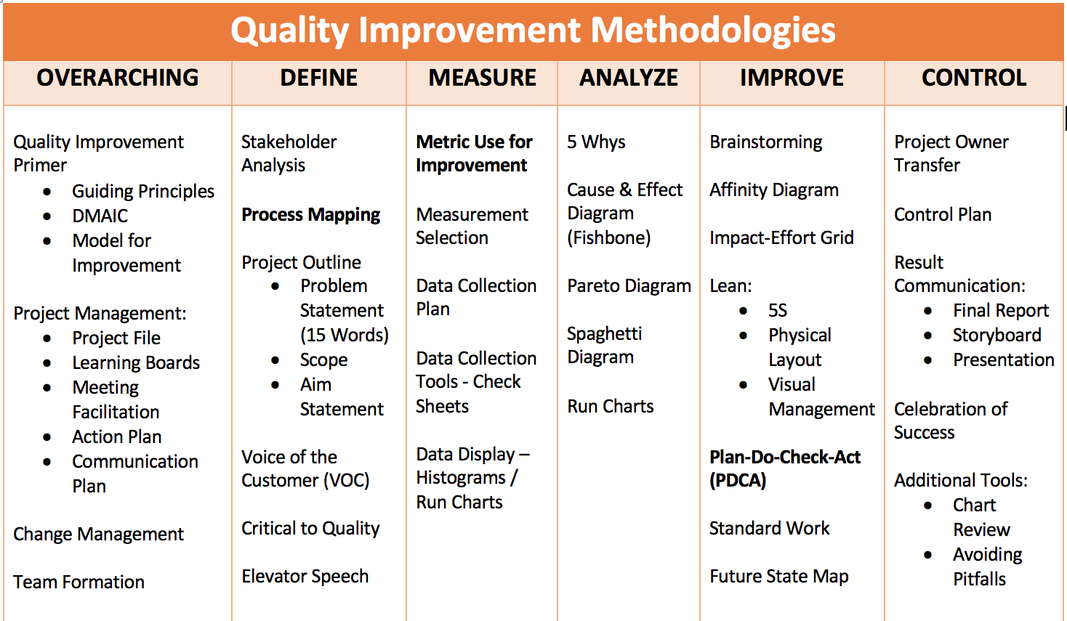
Structured curriculum covers >30 QI tools.
3 learning sessions + one workbook
WORKBOOK
(30+ tools)

Slide 14
QI 101: Introduction to Health Care Improvement
QI 102: How to Improve with the Model of Improvement
QI 103: Testing and Measuring Changes with PDSA Cycles
QI 104: Integrating data: Run Charts, Control Charts, and other Measurement Tools
QI 105: Leading Quality Improvement
QI 201: Planning for Spread, From Local Improvement to System-wide Change
L 101: Introduction to Helath Care Leadership
Subscription to the IHI Open School on-line courses complements the LARC curriculum.

Slide 15
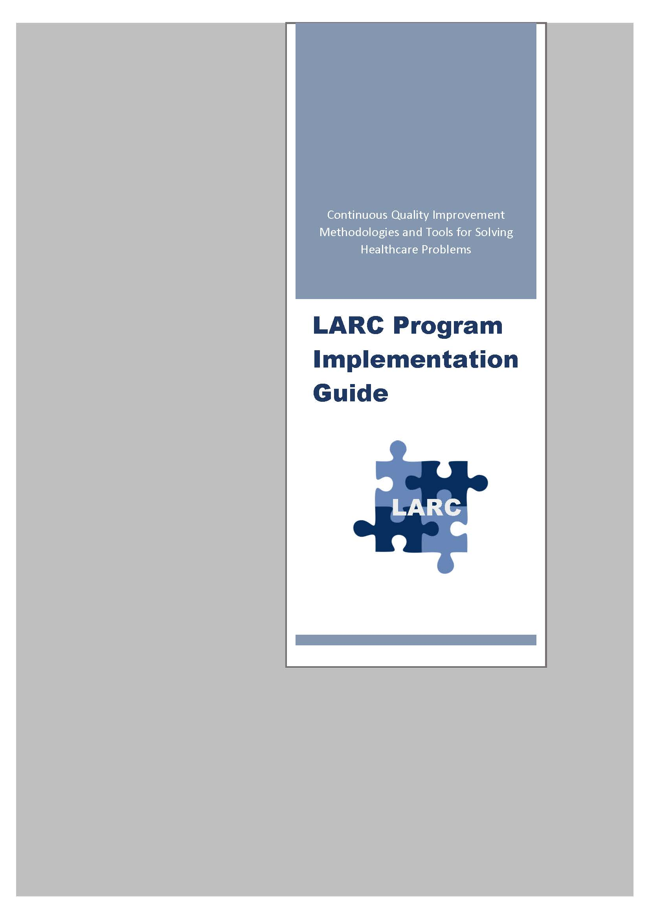
Program implementation usually spans 9-18 months, but can be shorter.
LARC Program Implementation Model
Introductory Webinar
Smart Start
(on site)
Learning Session I
Learning Session II
Learning Session III
Final Meeting
May 2018
Aug
2018
Aug 2018
Action Period
Action Period
Action Period

Slide 16
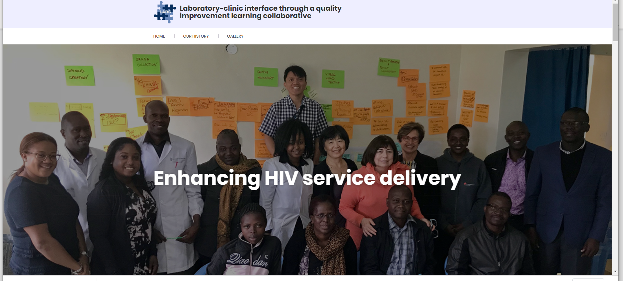
LARC website: A deposit of CQI tools and resources
LARCcqi.org

Slide 17

LARCcqi.org

Slide 18
Kenya implementation
11
sites
2 models
4
partners
Direct Assistance Model | Remote Assistance Model
UMB (Nairobi) - 5 sites | GIS (Western Kenya) – 4 sites FHI360 site (Rift Valley) – 1 site Amref (Eastern/Coastal) – 1 site
Notes:
使用方法：
【更改文字】：将标题框及正文框中的文字可直接改为您所需文字
【更改图片】：点中图片》绘图工具》格式》填充》图片》选择您需要展示的图片
【增加减少图片】：直接复制粘贴图片来增加图片数，复制后更改方法见【更改图片】
【更改图片色彩】：点中图片》图片工具》格式》色彩（重新着色）》选择您喜欢的色彩
下载更多模板、视频教程：http://www.mysoeasy.com

Slide 19
Presentation Outline
What is LARC?
Where did LARC come from?
What results have been achieved?
What’s next?

Slide 20
Demand Creation | Aim: To reduce % missed appointments for viral load test from 22% to 10% by March 2019
Interventions
Redesigned client flow for VL appointments
Created alert systems (stickers on patient files, EMR signal, patient appointment cards, printed list of patients due for VL the day before appointment)
PDSA 1
PDSA 2
PDSA 3
Notes:
Median = 7%

Slide 21
Result Reporting | Aim: To increase % hardcopy viral load results in the patient file from 0 % to 90% by March 2019
Interventions
Redesigned process flow - results printed by the lab
Assigned data manager to place hardcopy results in patients files
Notes:
Post Median = 80%

Slide 22
Patient Management | Aim: To decrease % patients with HVL not attending Enhanced Adherence Counseling within 30 days of receiving results from 48% to 10% by March 2019
Interventions - Restructured the patient notification process
Shortened TCA to < 30 days for all viral load patients
Called patients same day upon receipt of HVL results
Physical tracing for those whose phone calls don’t go through after three attempts in a week
PDSA 1
PDSA 2
The project baseline of 48% was for a 8-month period
Notes:
Median = 8%

Slide 23
One site reduced the number of missed appointments for viral load testing by 19 percentage points.

Slide 24
Seven sites improved viral load result documentation (in EMR, green cards, patient files) by 33-97 percentage points.
*Direct Assistance Sites

Slide 25
Two sites reduced the number of patients not attending EAC within 30 days of receiving results by 48 - 60 percentage points.
Site C1
Site C2
EAC = Enhanced Adherence Counseling

Slide 26
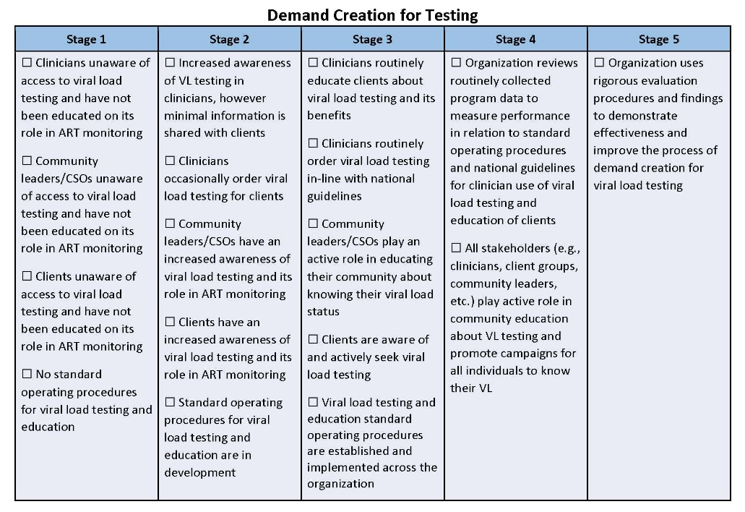
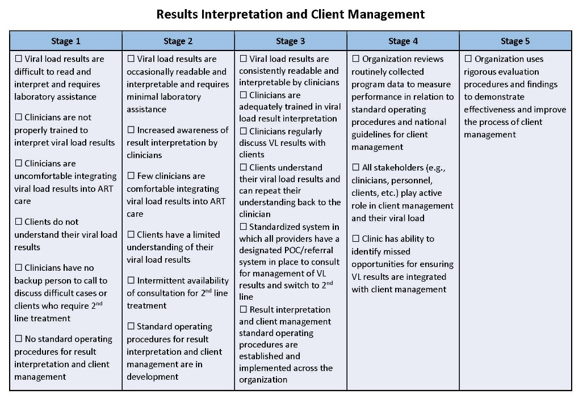
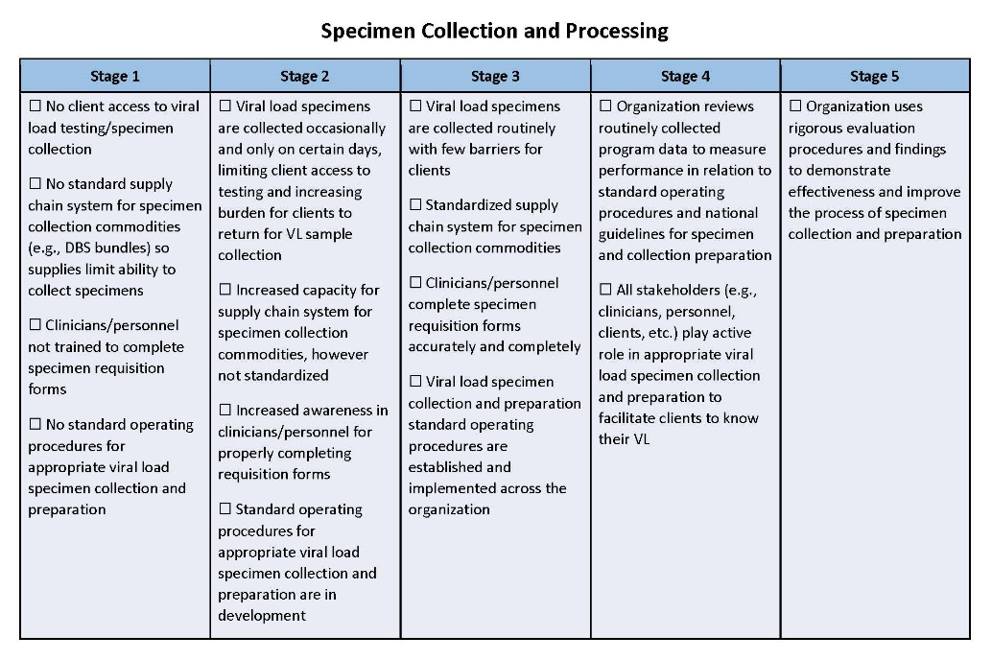
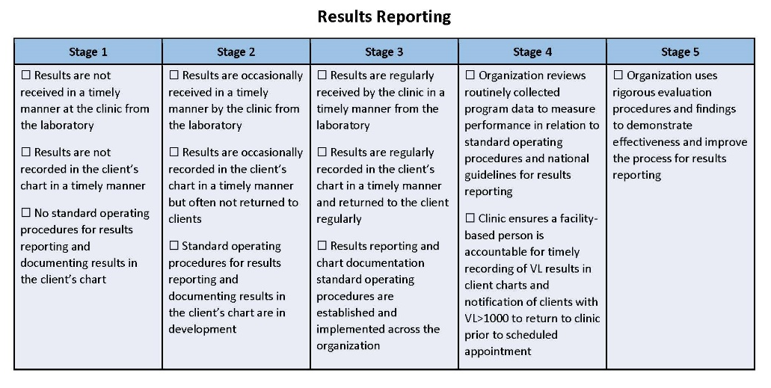
LARC Capability Maturity Model (CMM) measures improvement in organizational capability related to the Viral Load Cascade.
1
2
3
4
5

Slide 27
All 11 sites improved their institutional capability for VL scale-up. Patient management seems to be the hardest capability to develop.
Demand Creation
A
B
Result
Reporting
C
D
E
F
G
H
I
Patient
Management
J
K

Slide 28

In conclusion…
LARC is one of the few initiatives that bring laboratorians and clinicians together for problem solving and process improvement.
L
A
Through rigorous application of a structured Quality Improvement methodology and relentless focus on results and data, LARC has proven successful in producing remarkable and measurable results in Kenya.
R
C

Slide 29
Presentation Outline
What is LARC?
Where did LARC come from?
What results have been achieved?
What’s next?

Slide 30

LARC 3.0: Scalability

Slide 31
Key Guiding Principles
Partnership and co-design with the host country
A focus on lab-clinic collaboration and team building
Local decision making based on local (facility-level) data
Empowering of frontline workers at the facility level
QI capacity building for scale-up

Slide 32
Thank you

